Slide 1
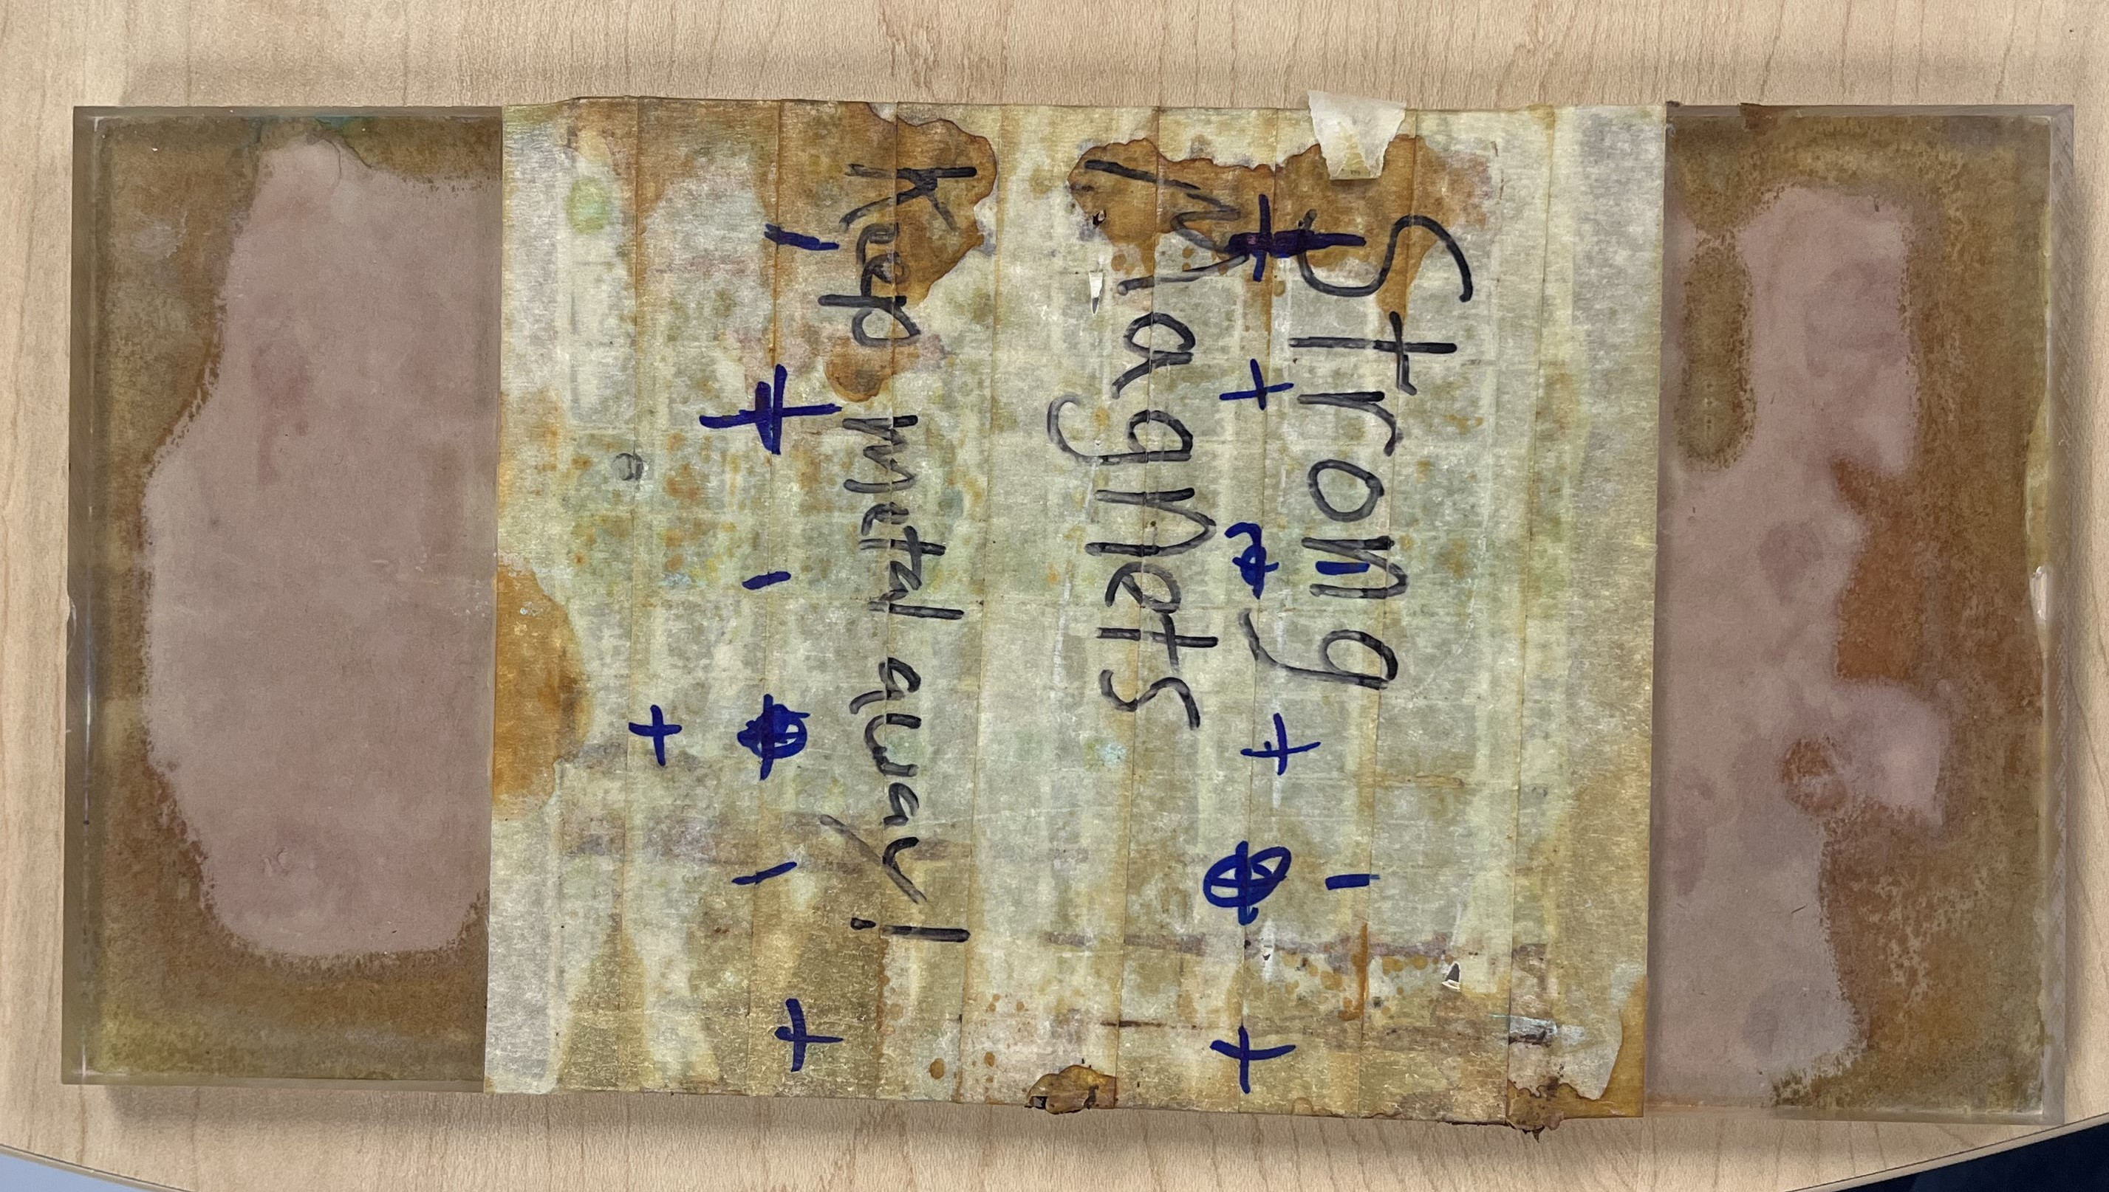
N N N N N N N N N N N N N
S S S S S S S S S S S S S S S S
N N N N N N N N N N N N N
S S S S S S S S S S S S S S S S
N N N N N N N N N N N N N
S S S S S S S S S S S S S S S S
N N N N N N N N N N N N N
S S S S S S S S S S S S S S S S
N N N N N N N N N N N N N

Slide 3
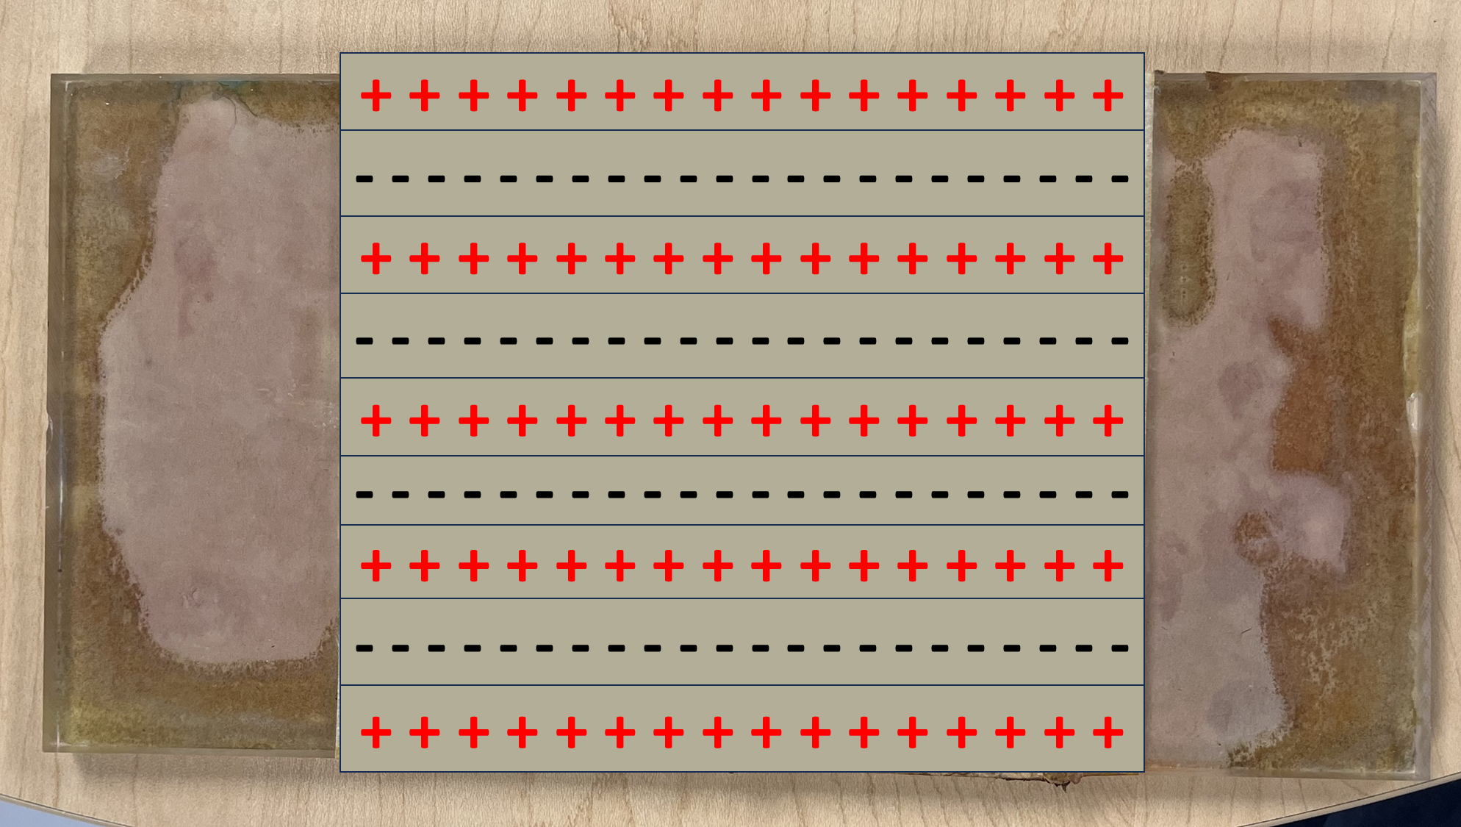

Slide 4
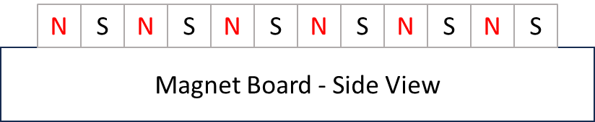
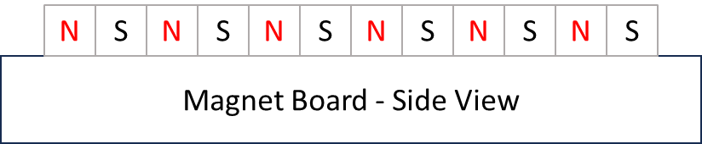
N
S
N
S
N
S
N
S
N
S
N
S
Magnet Board - Side View

